Slide 1
Hedonic Prices
Traditional Demand curve analysis
Choose the level housing consumption
Alternative setup is a discrete choice model
Choose a specific house from an available set

Slide 2
Hedonic Prices
According to Sherwin Rosen (1974),
“Hedonic prices are defined as the implicit prices of differentiated products and the specific amounts of characteristics associated with them”
“Implicit prices are estimated by the first-step regression analysis (product price regressed on characteristics) in the construction of hedonic price indexes”
An important notion is that goods are considered to be a vector of their “utility-bearing attributes or characteristics”

Slide 3
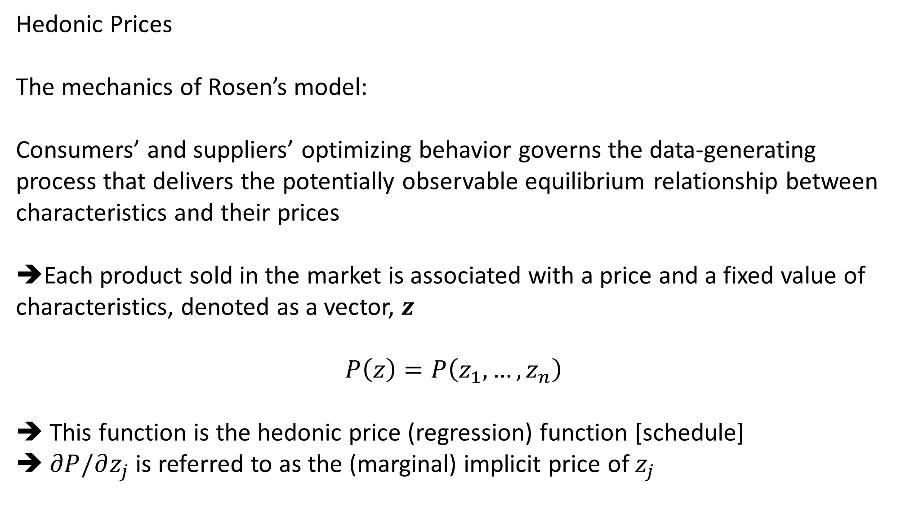
Hedonic Prices
The mechanics of Rosen’s model:
Consumers’ and suppliers’ optimizing behavior governs the data-generating process that delivers the potentially observable equilibrium relationship between characteristics and their prices
➔Each product sold in the market is associated with a price and a fixed value of characteristics, denoted as a vector, $z$
$$P\left(z\right)=P\left(z_{1}, …,z_{n}\right)$$
This function is the hedonic price (regression) function [schedule]
$∂P/∂z_{j}$ is referred to as the (marginal) implicit price of $z_{j}$

Slide 4
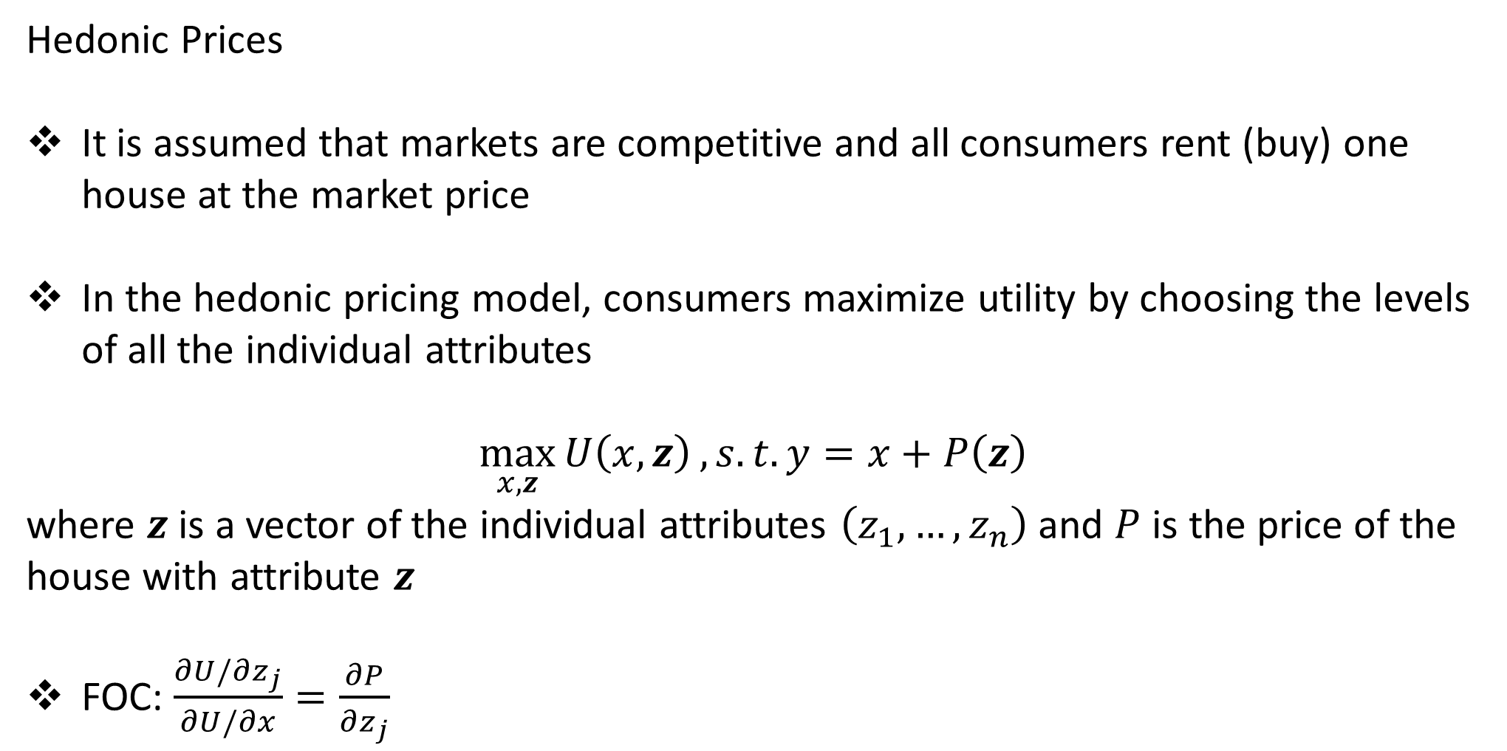
Hedonic Prices
It is assumed that markets are competitive and all consumers rent (buy) one house at the market price
In the hedonic pricing model, consumers maximize utility by choosing the levels of all the individual attributes
$$\max_{x,z}{U\left(x,z\right)}, s.t. y=x+P\left(z\right)$$
where $z$ is a vector of the individual attributes $\left(z_{1}, …,z_{n}\right)$ and $P$ is the price of the house with attribute $z$
FOC: $\frac{∂U/∂z_{j}}{∂U/∂x}=\frac{∂P}{∂z_{j}}$
Notes:
Marginal willingness to pay for $z_{j}$ must equal to the marginal cost of an extra unit of $z_{j}$ in the market

Slide 5
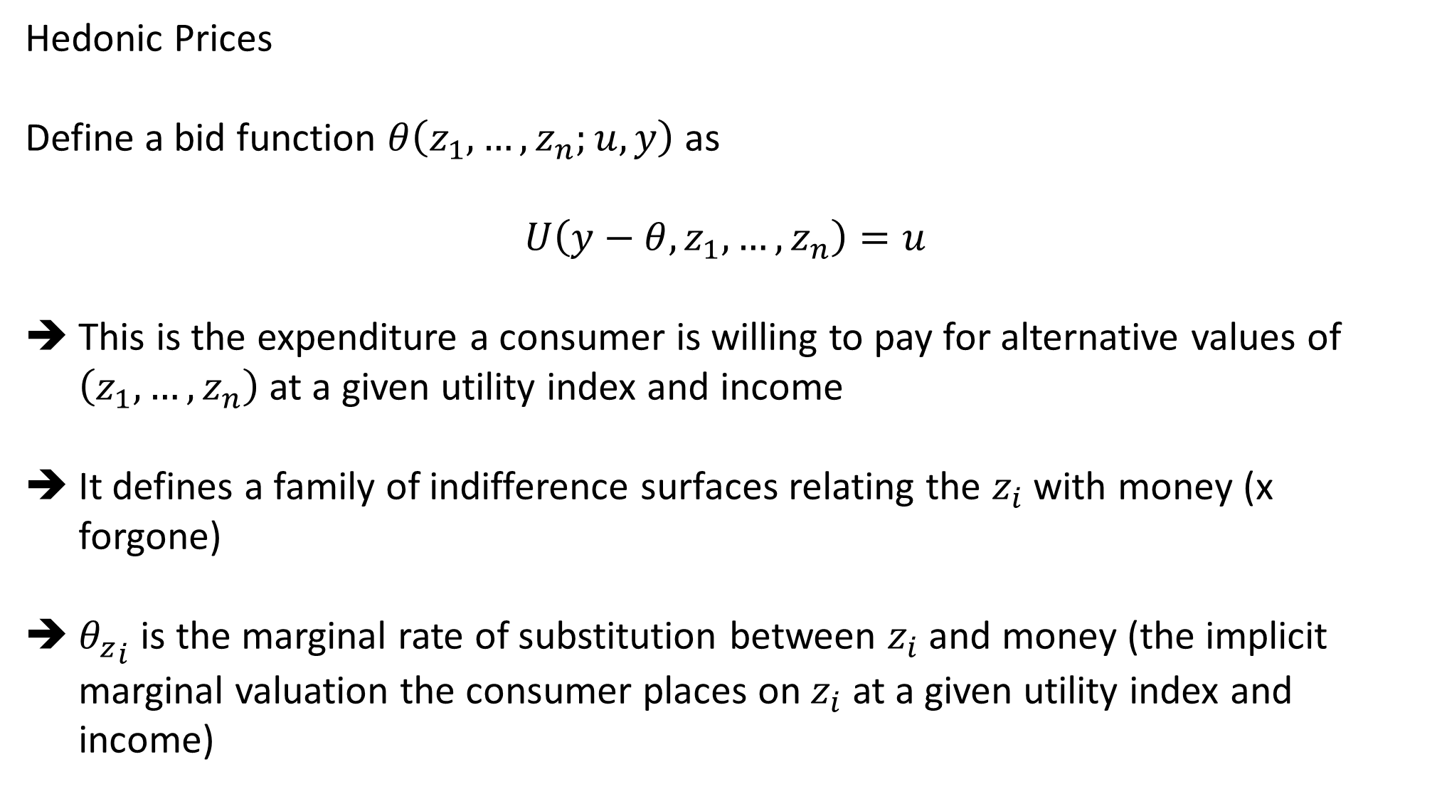
Hedonic Prices
Define a bid function $θ\left(z_{1}, …, z_{n};u,y\right)$ as
$$U\left(y−θ, z_{1}, …,z_{n}\right)=u$$
This is the expenditure a consumer is willing to pay for alternative values of $\left(z_{1},…,z_{n}\right)$ at a given utility index and income
It defines a family of indifference surfaces relating the $z_{i}$ with money (x forgone)
${θ_{z}}_{i}$ is the marginal rate of substitution between $z_{i}$ and money (the implicit marginal valuation the consumer places on $z_{i}$ at a given utility index and income)

Slide 6
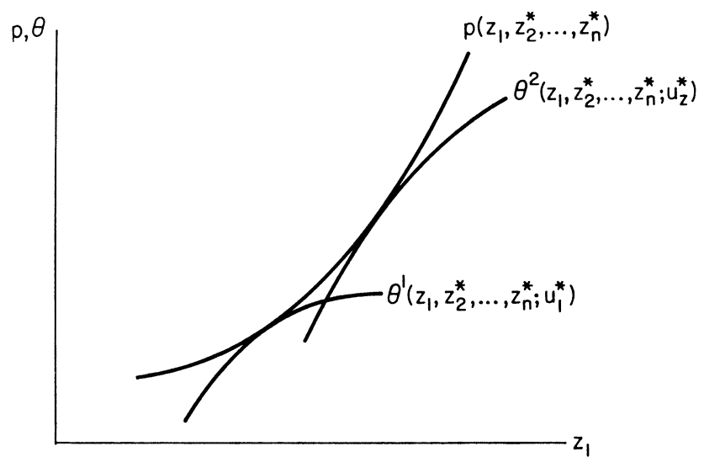
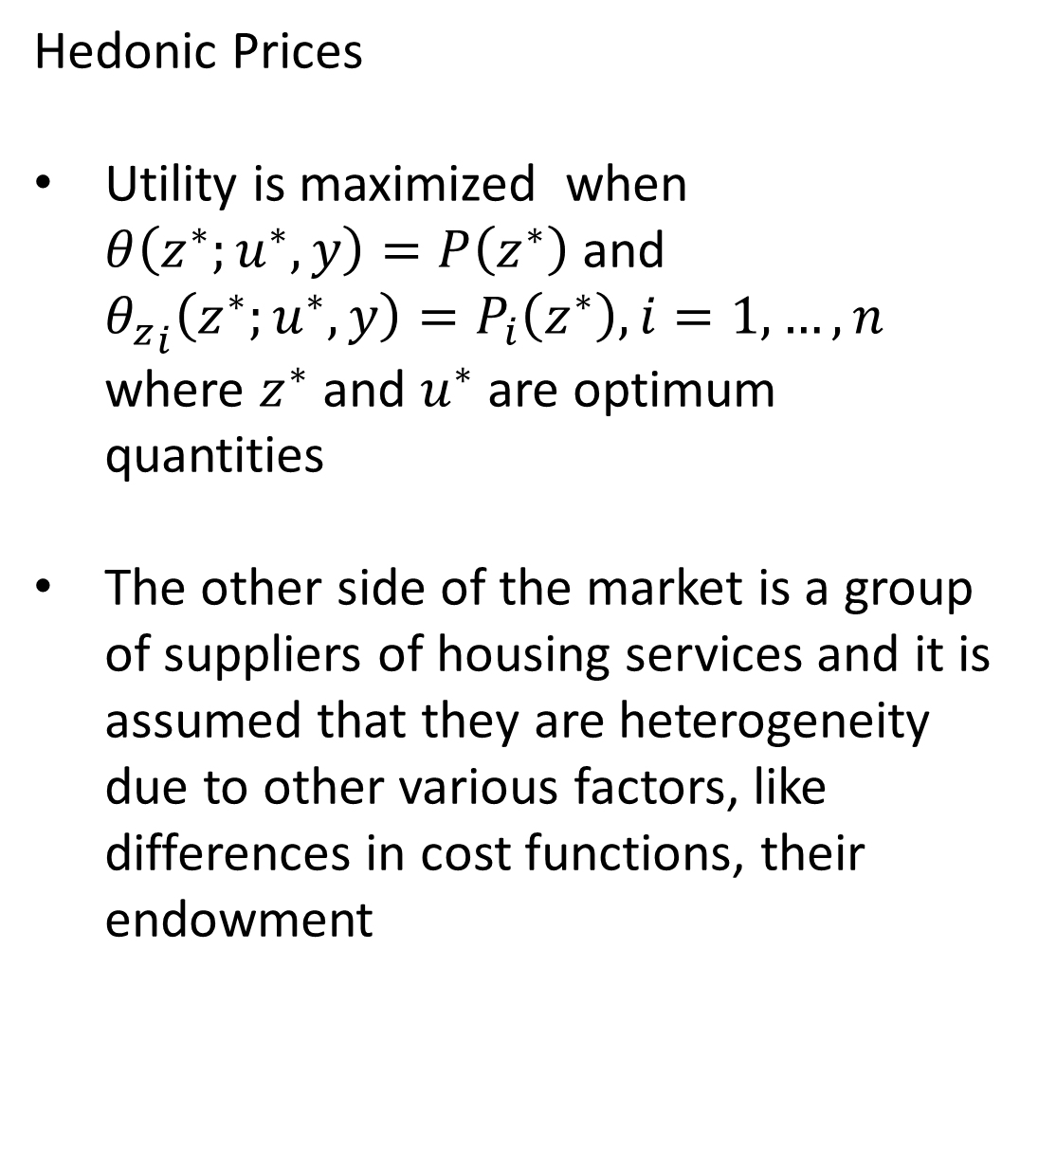
Hedonic Prices
Utility is maximized when $θ\left(z^{∗};u^{∗},y\right)=P\left(z^{∗}\right)$ and ${θ_{z}}_{i}\left(z^{∗};u^{∗},y\right)=P_{i}\left(z^{∗}\right), i=1,…,n$ where $z^{∗}$ and $u^{∗}$ are optimum quantities
The other side of the market is a group of suppliers of housing services and it is assumed that they are heterogeneity due to other various factors, like differences in cost functions, their endowment

Slide 7
Hedonic Prices
In most hedonic property value applications, the supply of houses is assumed to be fixed in the short run
➔ The equilibrium price schedule arises from home buyers bidding for a fixed supply of houses
The goal of analysis is to extract households’ willingness to pay for environmental attributes, like local school quality, local air quality, access to parks or lakes, etc.
This helps solving the fundamental challenge of environmental valuation that environmental amenities are not, in general, transacted in markets

Slide 8
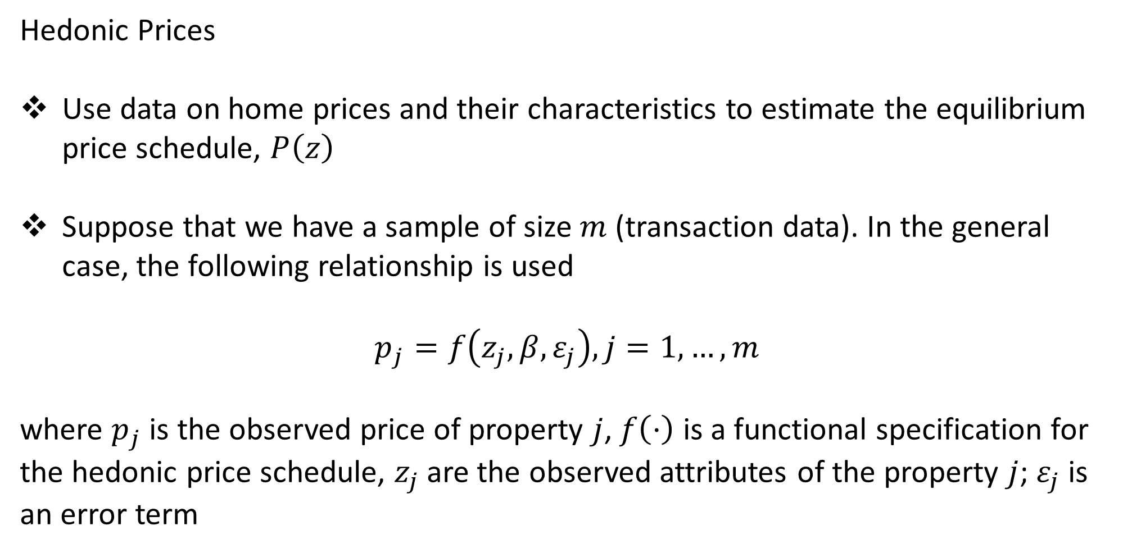
Hedonic Prices
Use data on home prices and their characteristics to estimate the equilibrium price schedule, $P\left(z\right)$
Suppose that we have a sample of size $m$ (transaction data). In the general case, the following relationship is used
$$p_{j}=f\left(z_{j},β, ε_{j}\right), j=1,…,m$$
where $p_{j}$ is the observed price of property $j$, $f\left(⋅\right)$ is a functional specification for the hedonic price schedule, $z_{j}$ are the observed attributes of the property $j$; $ε_{j}$ is an error term

Slide 9
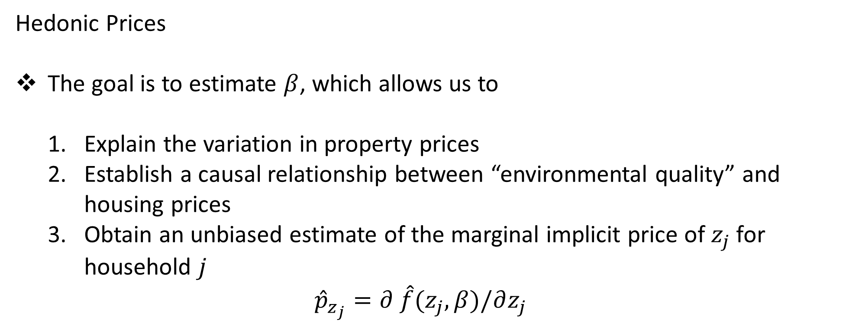
Hedonic Prices
The goal is to estimate $β$, which allows us to
Explain the variation in property prices
Establish a causal relationship between “environmental quality” and housing prices
Obtain an unbiased estimate of the marginal implicit price of $z_{j}$ for household $j$
$${\hat{p}}_{z_{j}}=∂ \hat{f}(z_{j},β)/∂z_{j}$$

Slide 10
Hedonic Prices
The difficulties in implementing the estimation
Sample Selection Bias
Extent of the market --- spatial and temporal
Specification of the hedonic price function
Omitted variable bias
Notes:
A two-step econometric procedure delivers the HPS and consumer’s bid functions, which allows conducting welfare analysis for non-marginal changes
The greatest promise of the Rosen model is not just to consistently estimate the HPS but to recover individuals’ bid functions
➔ Allows for assessing the welfare consequences of non-marginal changes and counterfactual policies

Slide 11
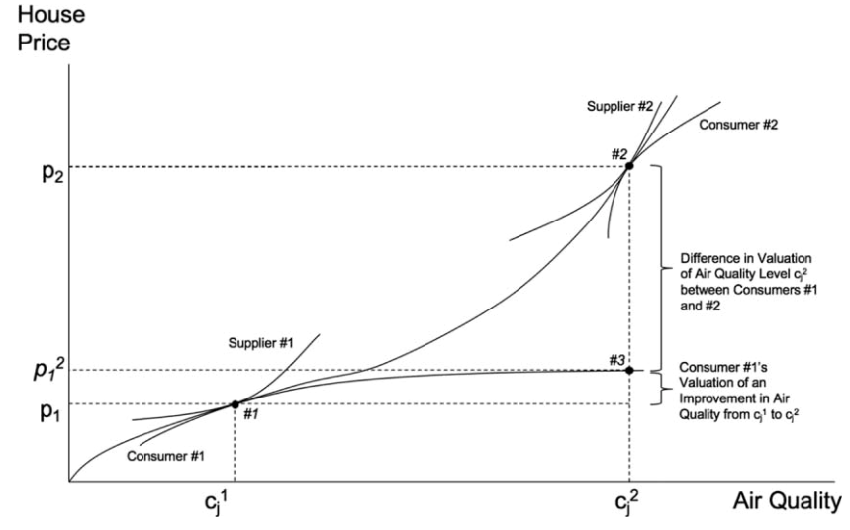
Hedonic Prices
Further illustration

